Slide 1
pairwise comparison
determine their relative importance

Slide 2
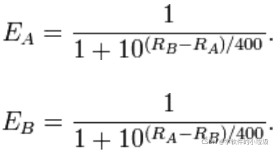

ELO
E_a prob of a win
R_a current score of a R’_a score after the match
K-factor one of the factor that determine how violently the score change, usually high if the player have high uncertainty (new players, old player who didn’t play for a while)

Slide 3


Bradley-Terry model
Calculate hidden “power value” p_i， using the existing comparison result and Maximum Likelihood estimation method

Slide 4
Rank Centrality
Assigns global scores to items from pair-wise comparison data
Using random walk on a comparison data, where an item‘s final score is its stationary probability
In short :using the win rate of the option to distribute a fix total score multiple times until the result converged

Slide 5
BWS
Participant compare between 3 or more options and chose the best and the worse from it and do severe groups of comparison
Calculate how many times each option was voted as best and as worst
Subtract the number of worst votes from the number of best votes for each option， and then rank the options by that result
**Thurstone – only compare 2 options, rank by win rate

